Slide 1
Group One
Saeed AlSarhi
Alberto Clara
Patrick Wellington

Slide 2
Project
Create a Search Engine that will scrape from (IMDB)
Feature 1: Link to IMDB (Trailers)
Feature 2: Allow user to use voting mechanism

Slide 3
Web Scraper
Scraping IMDB
Data we are scraping:
Title
Release
Description
Rating
IMDB URL
Number of votes
CSV file

Slide 4
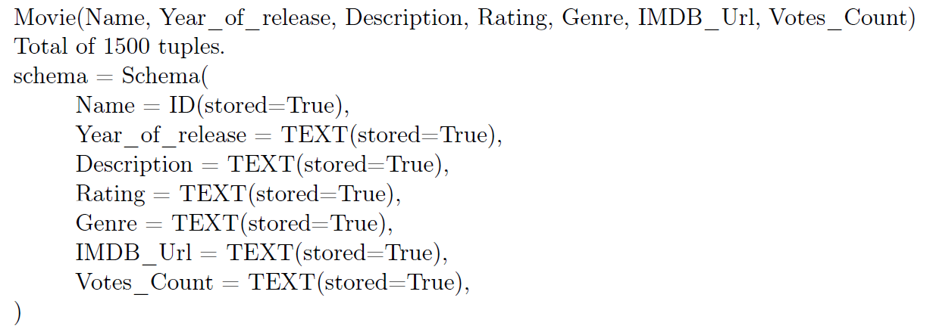
Schema

Slide 5
Feature 1: Link to IMDB
Ability to redirect user to actual content (IMDB)
Users may use IMDB link as an option to view the movie trailer
(Shown in Web Interface Slide)

Slide 6
Feature 2: Ratings
Allow users to view ratings of movie
View how many people have rated the movie
Being able to cast a vote and being reflected in our database.

Slide 7
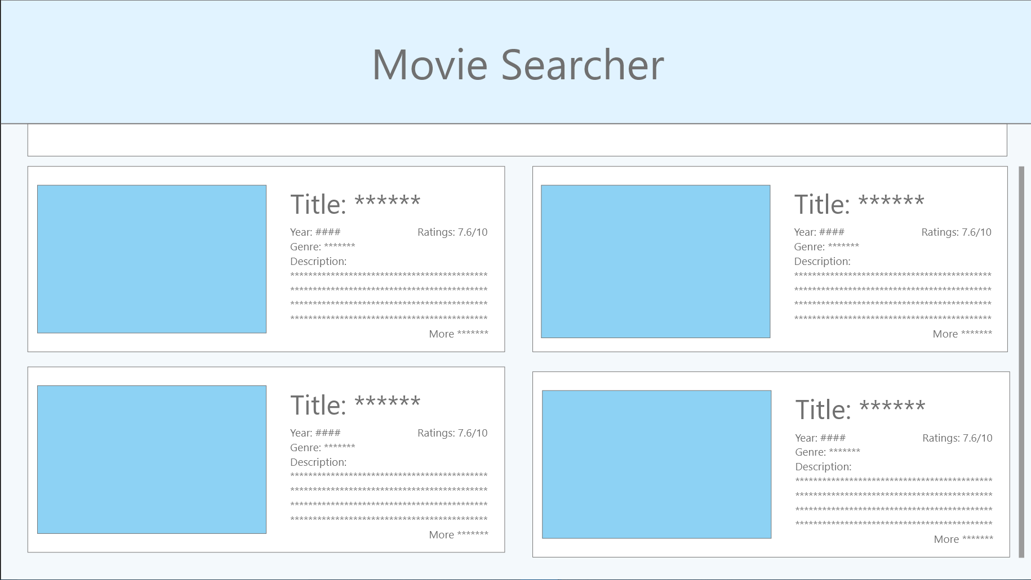
Web Interface (1/2)

Slide 8
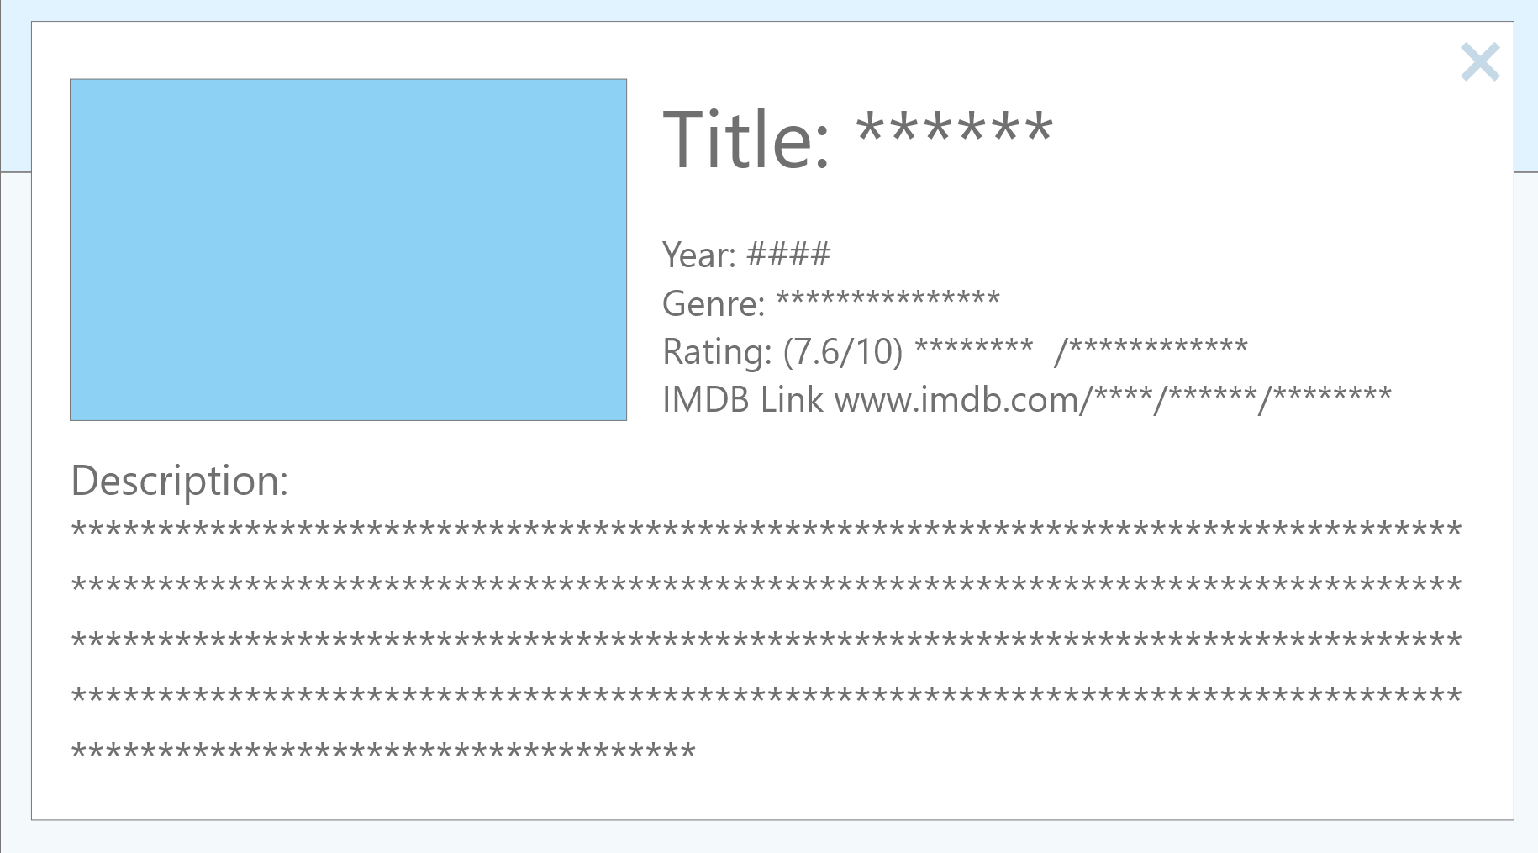
Web Interface (2/2)

Slide 9
Questions???

